Slide 1
Time-Frequency Representations Part I
COMP.SGN.120
Introduction to Audio processing
Lecture 4

Slide 2
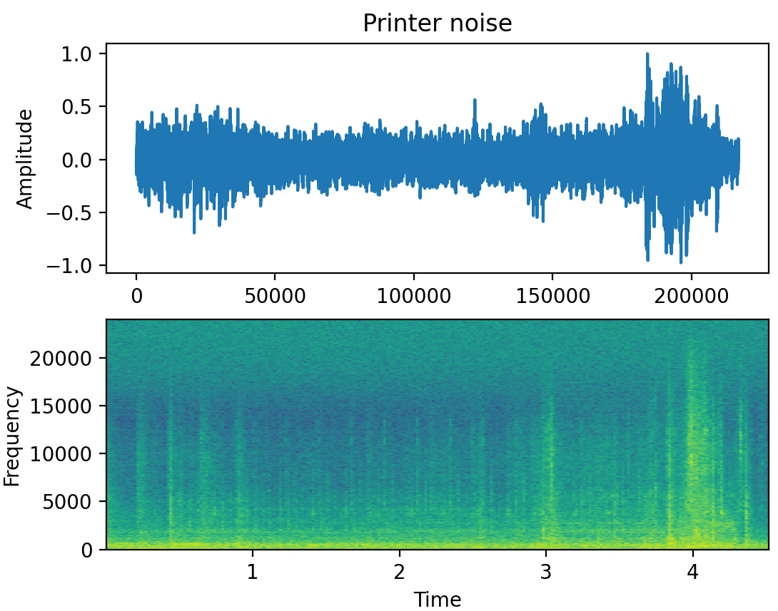

Time vs time-frequency representation
Time domain: More difficult to verify signal assumptions about noise stationarity.
Time-frequency representation: Notice noise is stationary in some spectral bins over time.

Slide 3
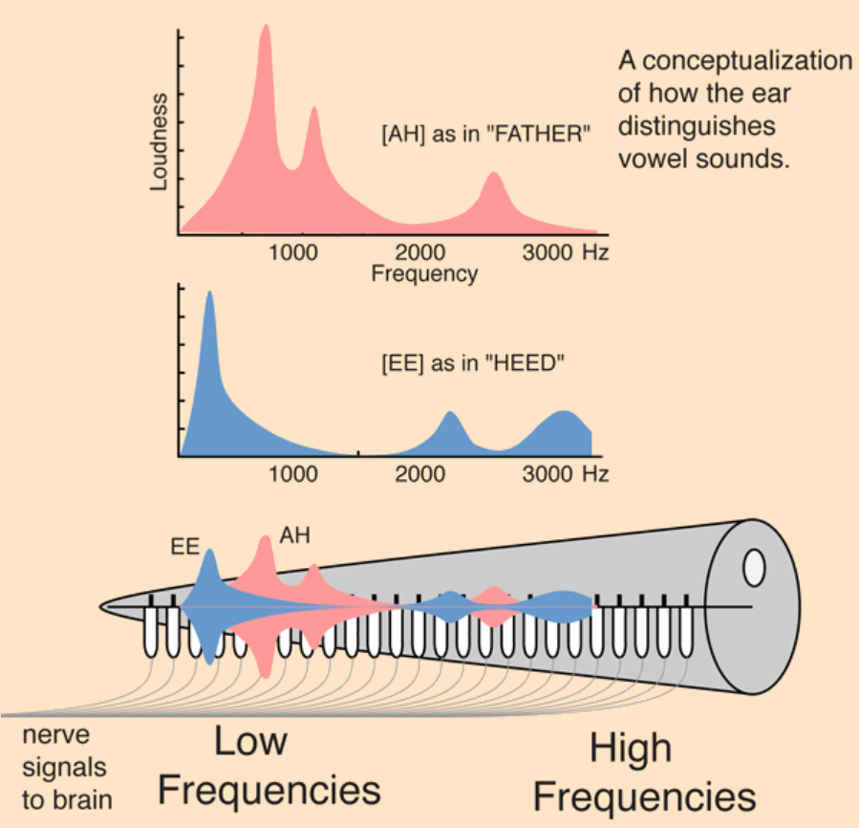
Time-Frequency domain
The audio signal is divided into frequency bands.
Applications:
Data compression
Audio effects
Enhancement of audio quality
Time-frequency processing is inspired by the structure of human hearing mechanism.
Re-cap:
Peripheral hearing system can be seen as spectral analyser that extract several perceptual aspects.
Figure from [http://hyperphysics.phy-astr.gsu.edu/hbase/Sound/cochimp.html]

Slide 4
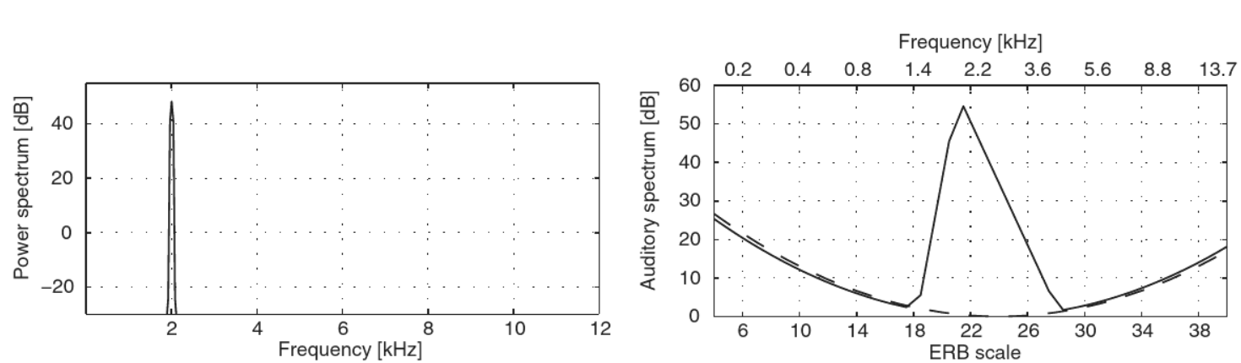
Time-Frequency domain
Linear power spectra and auditory spectra of a 2 kHz pure tone
Auditory spectrum differs from the power spectrum due to the use of the ERB (Equivalent Rectangular Bandwidth) scale, the spreading of the excitation to adjacent frequency bands and the emulation of the hearing threshold.

Slide 5
Spectrum analysis
Representing signals in spectral domain
Decomposition into their frequency components
Similar to human ear analysis
Spectrum analysis = (typically) magnitude spectrum
Because auditory system is relatively insensitive to phase!
Real listening conditions contain reflections from nearby surfaces and reverberation, hearing developed to be almost immune to phase.
dB scale to mimic perception of the signal level (mostly)

Slide 6
Transforms
Changing the representation of a signal from one form to another by applying mathematical transformations.
Inner product:
Quantifies the similarity/dissimilarity of two signals.
Used to ﬁnd properties of an unknown signal by comparing it to one or more known signals.
Provides the basic deﬁnitions of a variety of transform techniques e.g. Fourier and wavelet transforms or nonorthogonal periodicity transforms.

Slide 7
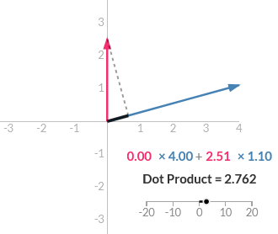
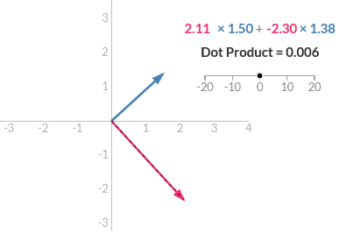
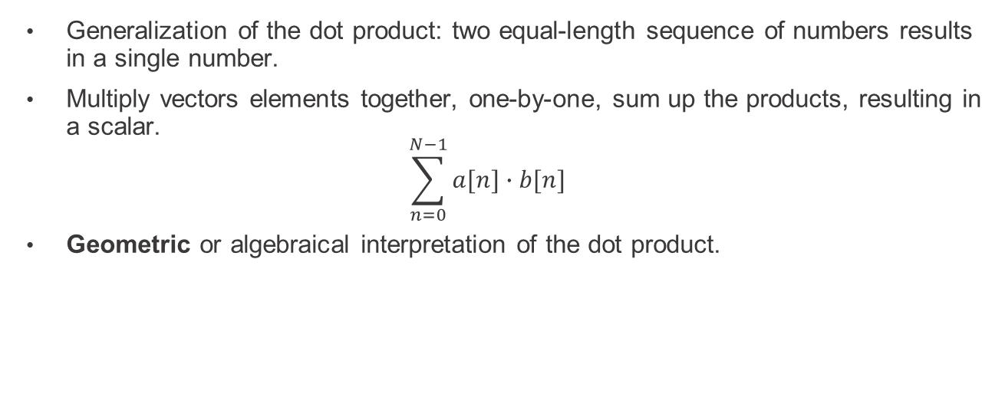
Inner Product
Generalization of the dot product: two equal-length sequence of numbers results in a single number.
Multiply vectors elements together, one-by-one, sum up the products, resulting in a scalar.
$$\sum_{n=0}^{N−1}{a[n]∙b[n]}$$
Geometric or algebraical interpretation of the dot product.

Slide 8
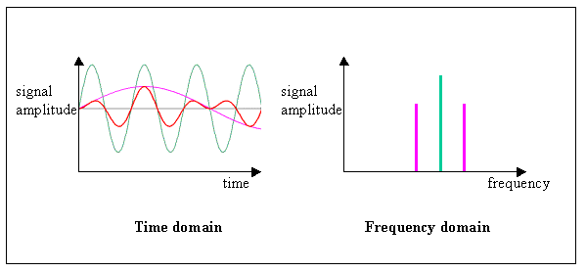
Time-frequency representations
Represent signal changes in both time and frequency at the same time!
Spectrogram
Time-frequency analysis
Allows separate processing of the signal in different frequency bands according to time.
How much of the signal is present among each given frequency band.
Allows processing modeled based on human hearing mechanisms.

Slide 9
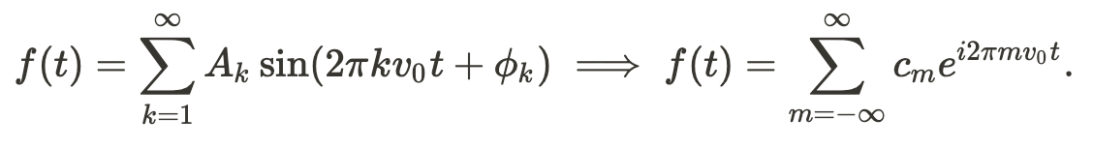
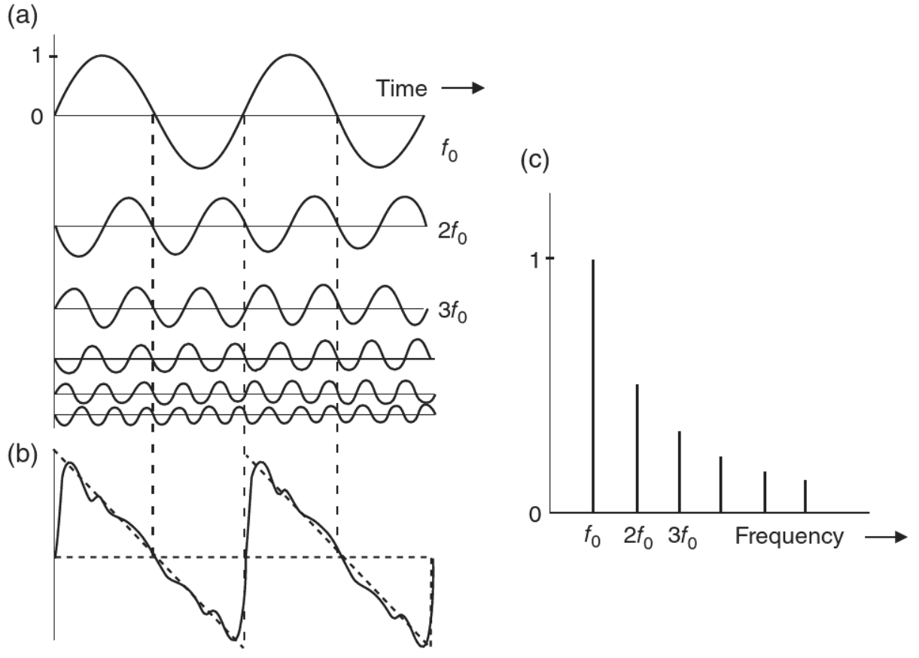
Fourier Transform
Fourier analysis
Used in a large variety of signal processing techniques (not just audio!)
Decomposition of the signal into basic functions
Basic functions: infinite number of weighted sinusoids with specific frequency and phase values.
Fourier analysis: decompose the waveform into its components.
Fourier synthesis: putting together these components.

Slide 10
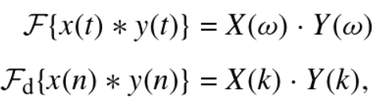
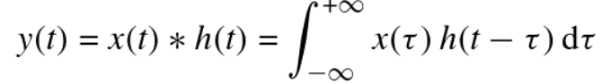
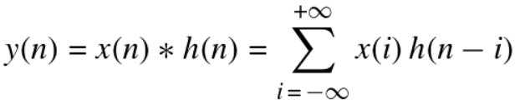
Fourier Transform
Advantages:
Converts the computationally expensive convolution in time domain into a much simpler multiplication in the frequency domain. Computationally demanding operation if the response sequences are long.
x, y denote time signals
X, Y denote their frequency-domain transforms
Convolution integral for the continuous-time signals
Convolution sum for the discrete-time signals

Slide 11
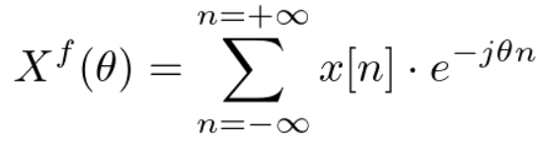
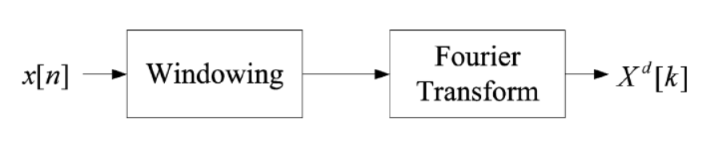
Discrete-Time Fourier Transform (DTFT)
Continuous-time Fourier transform uses integration which is impractical for computer based applications.
We sample the signal to convert the integral to a summation.
DTFT operates on sampled and windowed input signals of window size N.

Slide 12
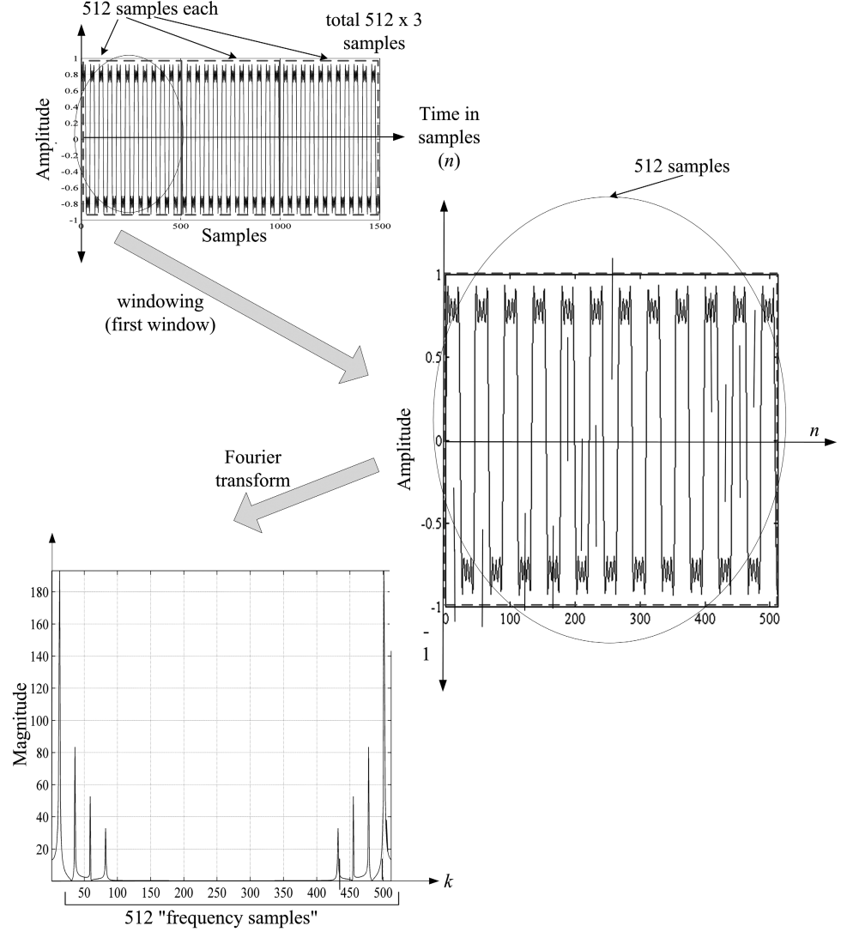
DFT
Discrete Fourier Transform
E.g (N=512):
Fourier transform is applied
Maps 512 time-domain samples to 512 frequency-domain samples.
These correspond to a frame.
Each frame is referred to as a spectrum.
The discrete points on the frequency axis are referred as frequency bins.
Each frequency component represent sinusoids with unique frequency values and their respective magnitude.

Slide 13
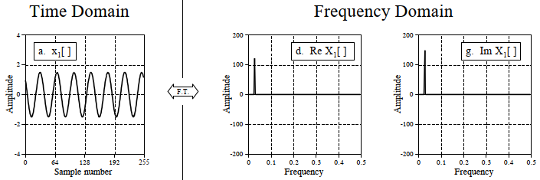
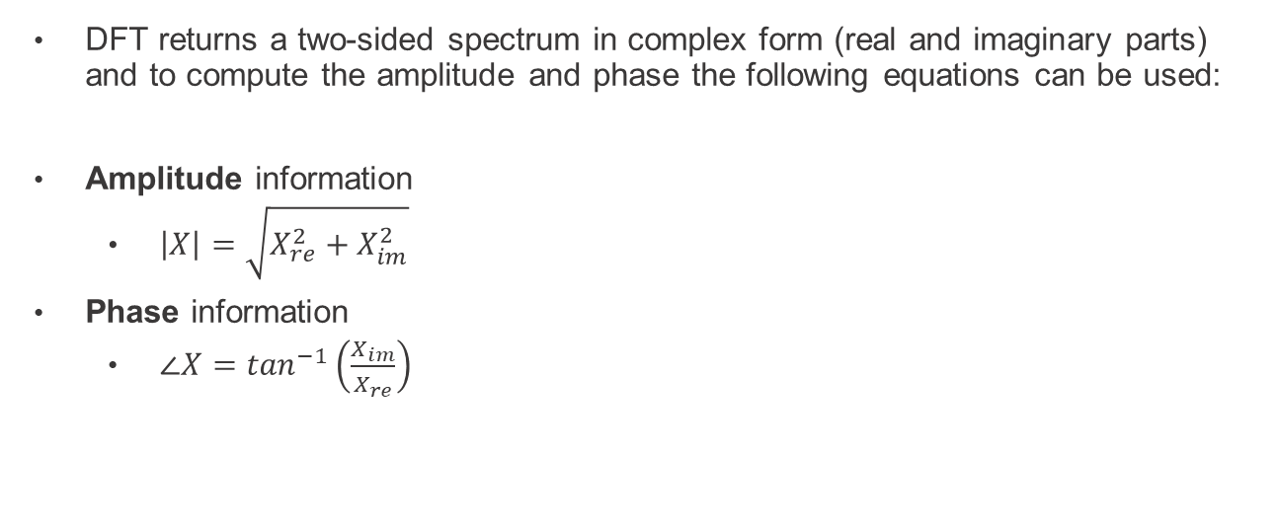
Discrete Fourier Transform
DFT returns a two-sided spectrum in complex form (real and imaginary parts) and to compute the amplitude and phase the following equations can be used:
Amplitude information
$\left|X\right|=\sqrt{X_{re}^{2}+X_{im}^{2}}$
Phase information
$∠X=\tan^{−1}\left(\frac{X_{im}}{X_{re}}\right)$
Every frequency component has a magnitude and phase.

Slide 14
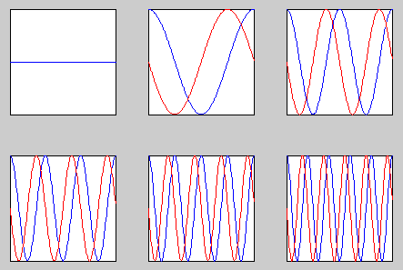
Discrete Fourier transform
First few basis functions (blue: real part, red: imaginary part)
k=0
k=1
k=2
n=0,...,N-1
n=0,...,N-1
k=3

Slide 15
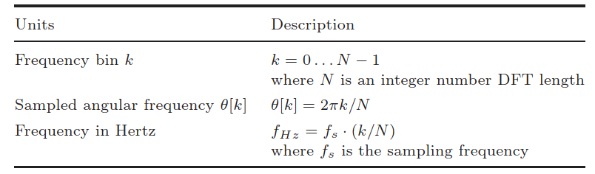
Frequency axis units

Slide 16
DTFT vs DFT
DTFT
Infinite continuous sequence of a discrete signal.
From minus infinity to plus infinity, contains positive and negative values of frequencies.
More accurate.
DFT
Finite non-continuous sequence of a discrete signal.
From 0 to N-1, only positive frequencies.
Need high number of samples to be accurate, at the same time increase computational power.
BOTH: Do not indicate how the frequency content of a signal changes over time.

Slide 17
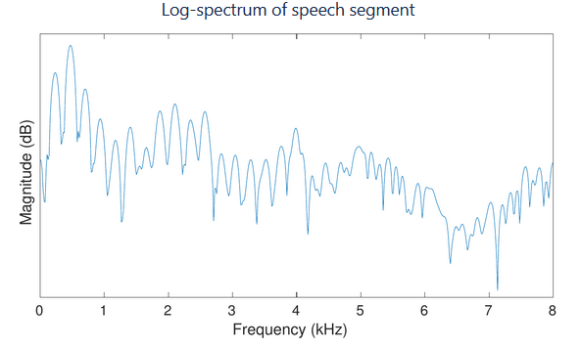
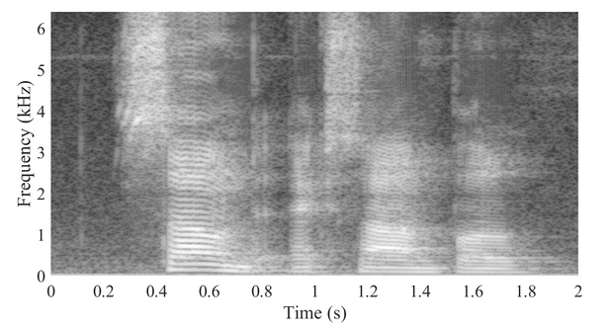
Spectrum vs spectrogram
Spectrum, represents perception of the frequency of a sound.
Spectrogram, three-dimensional mapping.

Slide 18
Short-Time Fourier Transform
To overcome the limitations of the Fourier Transform.
Use frame-based processing
Sequential processing of small-time frames
Assumes signal is time-invariant within this frame length
Signal is divided into frames: kth frame if input signal is x(n+Lk)
n=0,…,N, where N is window length,
k=0, 1, 2,… is window index
L is hop size overlapping frames!
Typical frame length is 20 ms (speech) to 100 ms (music)

Slide 19
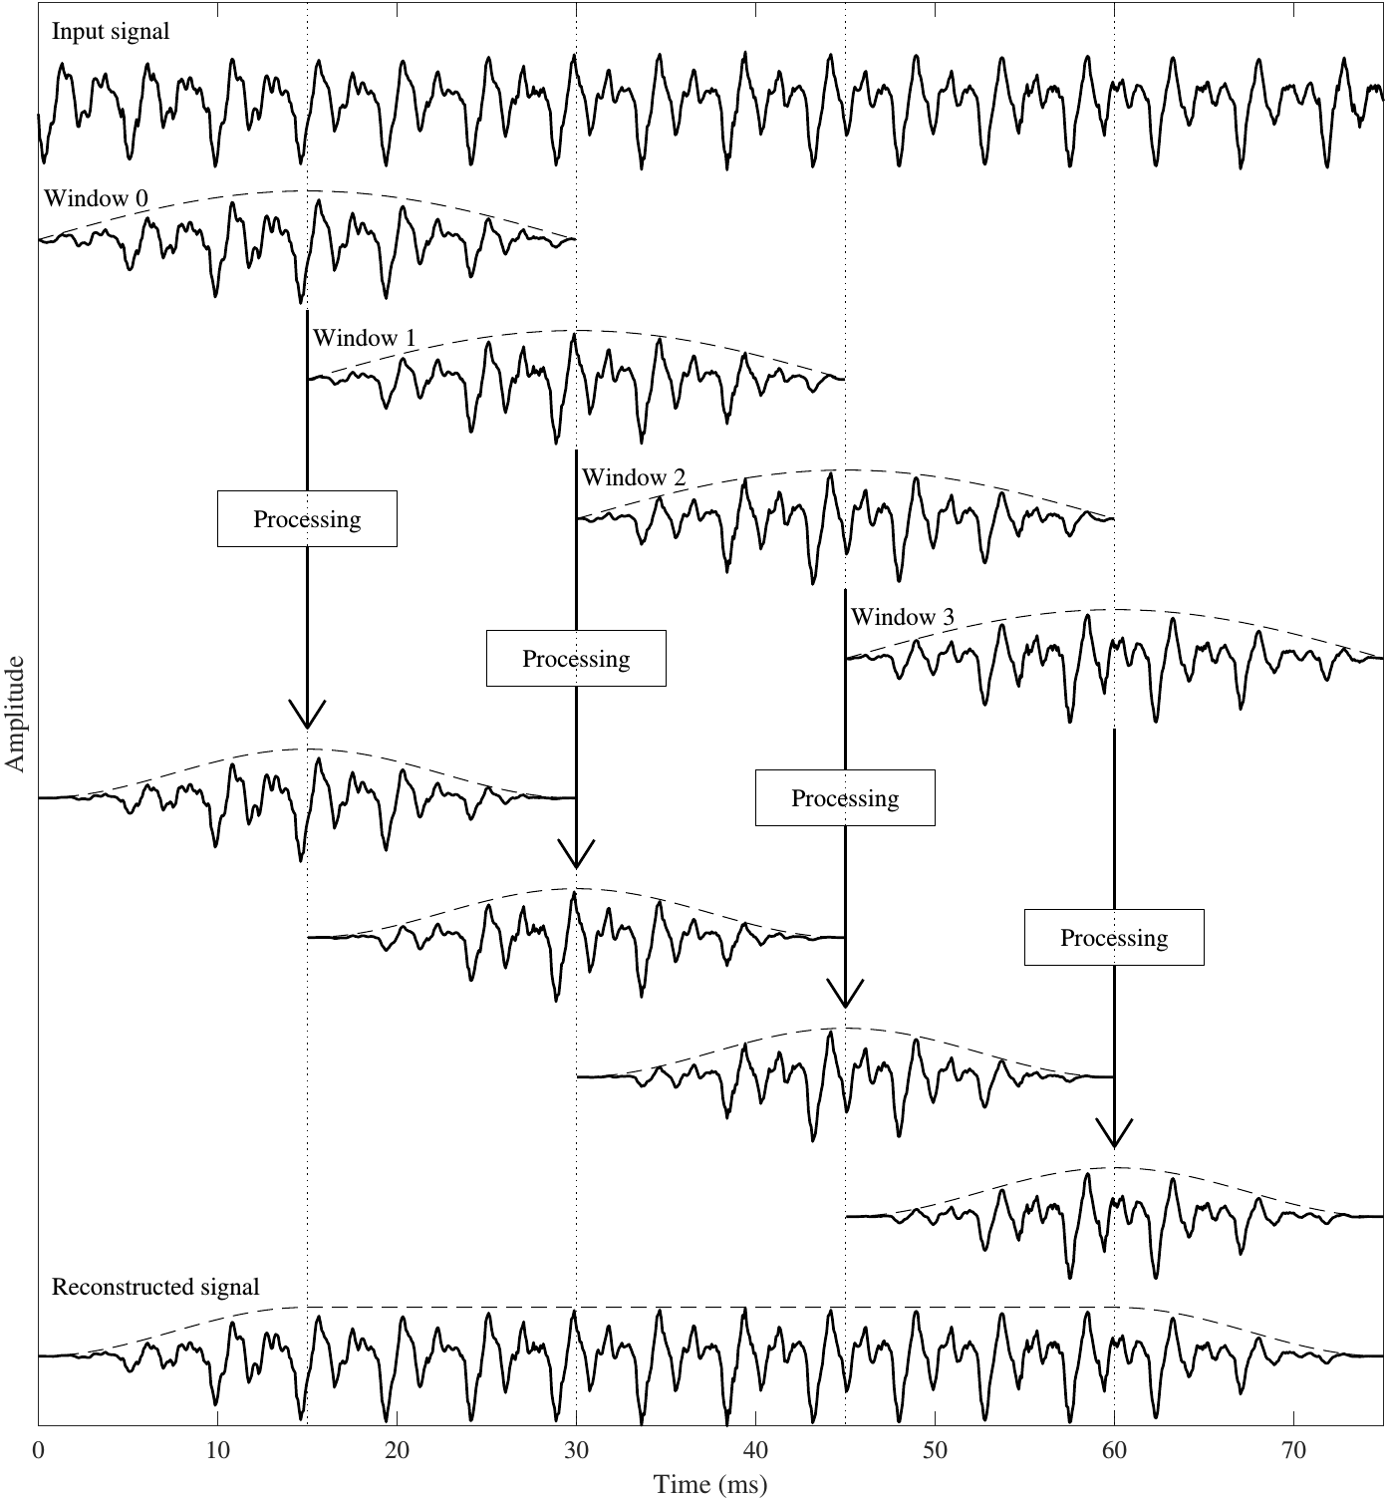
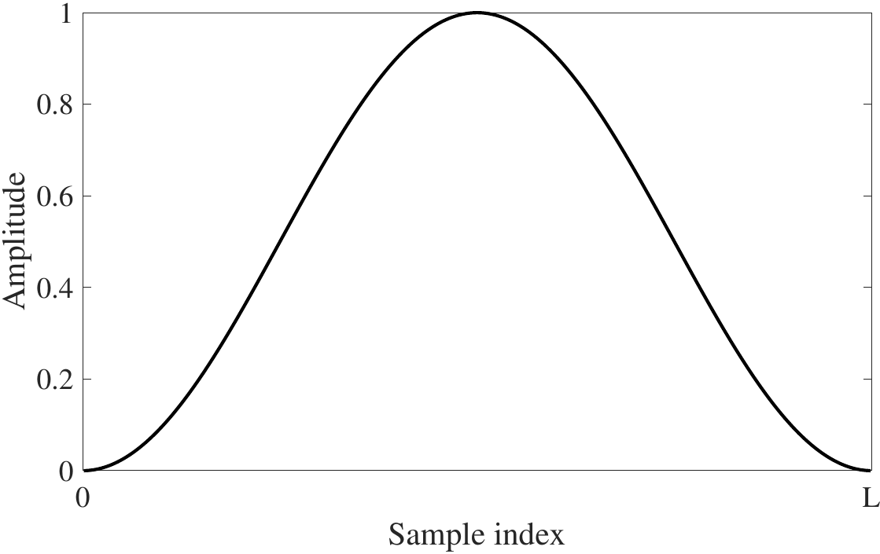
STFT
The signal is Split into short segments: windowing, splitting the input signal into temporal segments.
DFT is applied to each analysis window sequence.
Windowing functions: smooth functions which fo to zero at the borders.

Slide 20
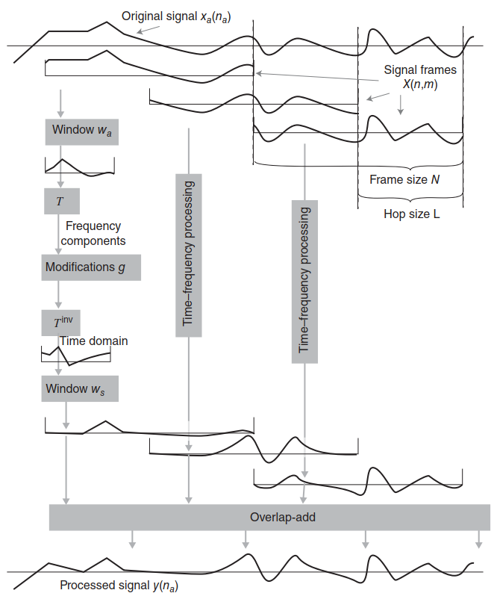
Schematic example of a short-term transform
Modifications (g) of the spectral components implement a high-pass filter
Communication acoustics: an introduction to speech, audio and psychoacoustics
Pulkki, Ville, author. Karjalainen, Matti, 1946-2010, author. 2015

Slide 21
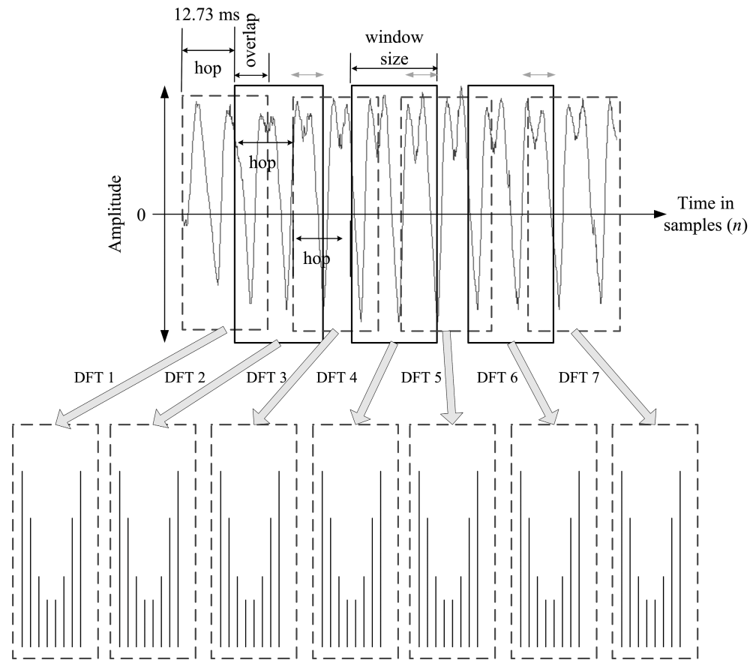

Slide 22
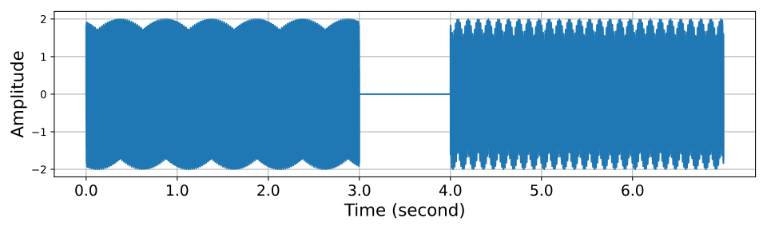
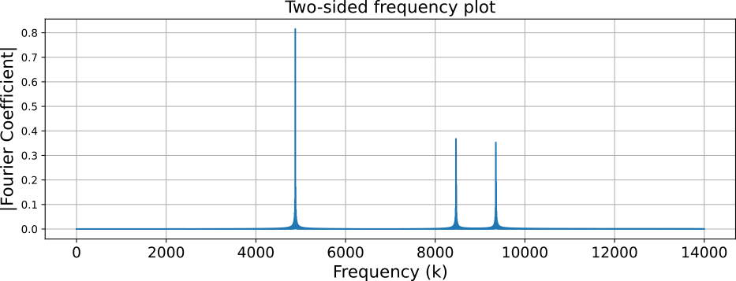
Python example
Simulated 7-second-long signal, first three seconds are two waves at frequency 697 Hz and 1209 Hz. The last three seconds are two sine waves at 697 Hz and 1336 Hz.
The DFT shows three peaks, which correspond to the three frequencies of the signal.
Note: We take half of the signal because the signal is real.
Means that its spectrum is Hermitian (“conjugate symmetric”)

Slide 23
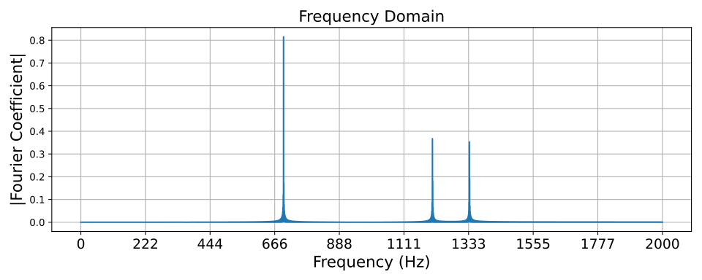
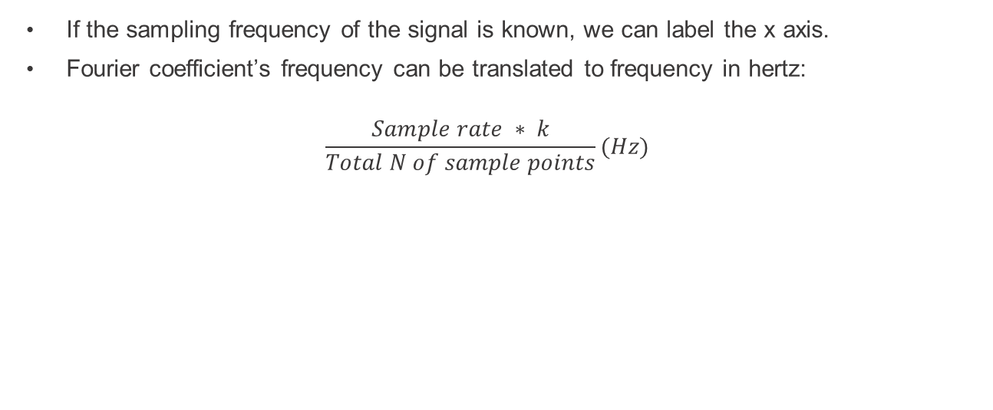
Python example
If the sampling frequency of the signal is known, we can label the x axis.
Fourier coefficient’s frequency can be translated to frequency in hertz:
$$\frac{Sample rate ∗ k}{Total N of sample points}(Hz)$$
Peaks correspond to:
697 Hz
1209 Hz
1336 Hz

Slide 24
STFT Python example
$$X\left(k\right)= \sum_{n=0}^{N−1}{w_{a}\left(n\right)x(n)e^{−j2πkn/N}}$$
Python
def get_xk(Xn,n):
'''
calculate the Fourier coefficient X_k of
Discrete Fourier Transform (DFT)
'''
N = len(Xn)
kn = np.arange(0,N,1)
xk = np.sum(Xn*np.exp((1j*2*np.pi*kn*n)/N))/N
return(xk)

Slide 25
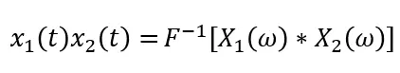
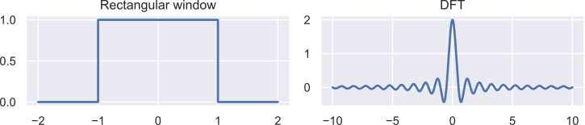
Windowing
Naive framing approach: just use signal values within the time frame
Implicit rectangular window
Multiplication in time domain = convolution in frequency domain
Magnitude response of a rectangular window (w(n)=1) is a sinc() function.
This can smear the spectrogram and result in reduced resolution
Also allows real-time processing for communication applications

Slide 26
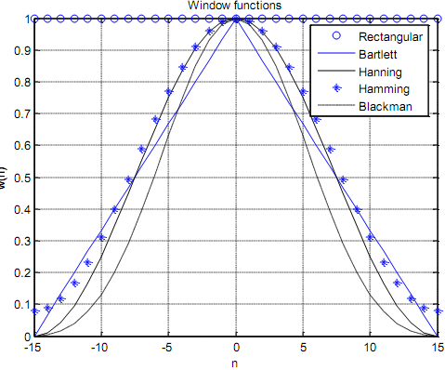
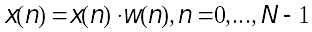
Windowing
For each audio frame, a window is applied:
w(n) is the windowing function
rectangular window w(n)=[1,1,…,1]
Compromise between spectral and temporal resolution.

Slide 27
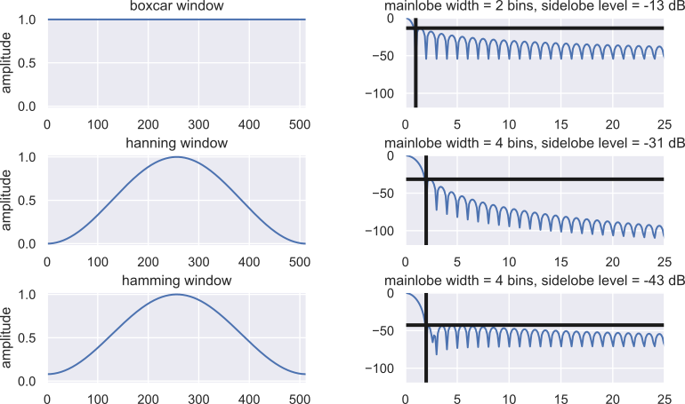
Special window functions w(n) are used

Slide 28
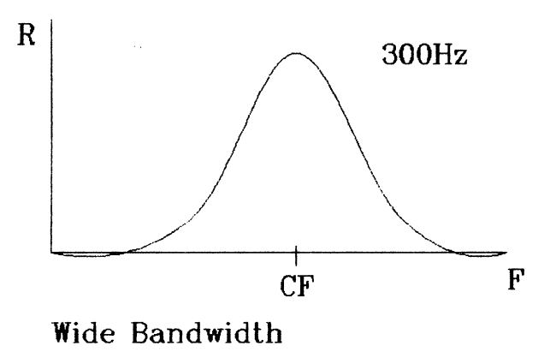
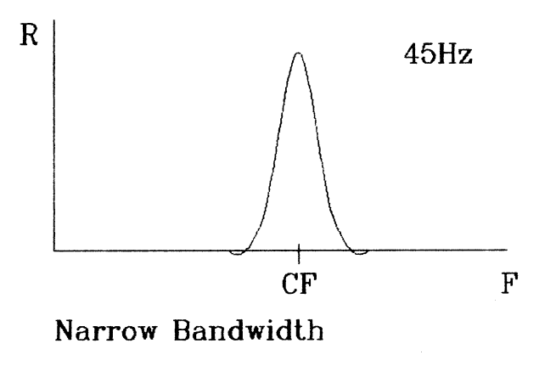
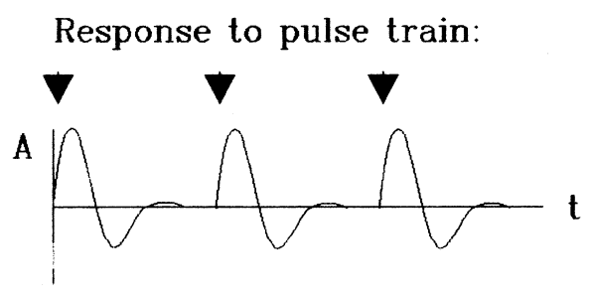
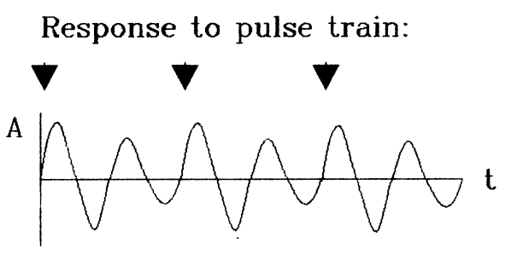
Wide – Narrow - band
Poor frequency resolution
Good Time resolution
Good frequency resolution
Poor Time resolution

Slide 29
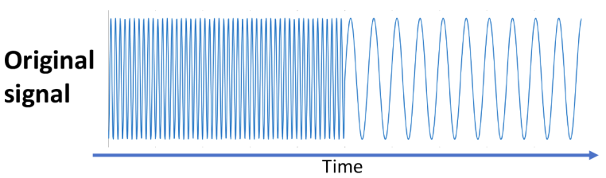
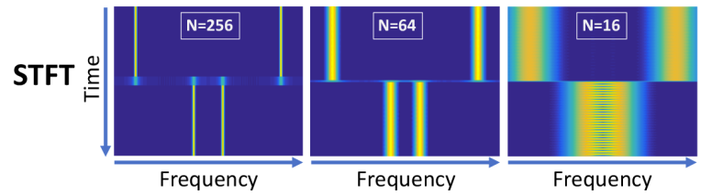
Effects of window selection
Narrow window = in order to enable fine temporal resolution, when our signal has rapidly fluctuating properties.
Wide window = when the signal has slowly fluctuating properties, to allow fine frequency resolution.
There is a trade-off between temporal and frequency resolution.

Slide 30
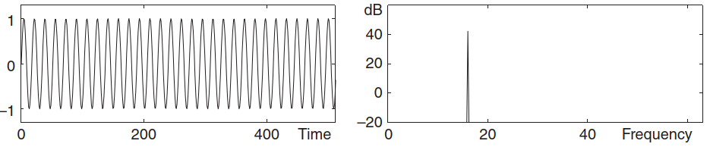
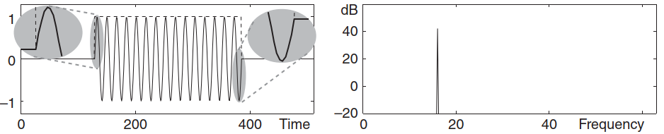
Effects of window selection
With a very long window (infinite)
Rectangular window synchronized with the periodicity of the sine wave.

Slide 31
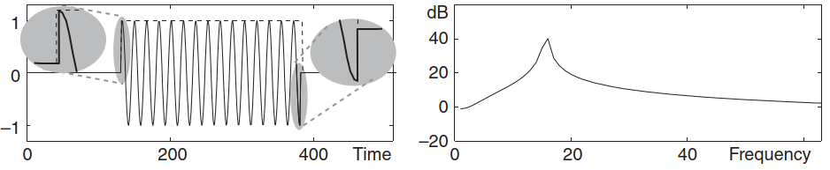
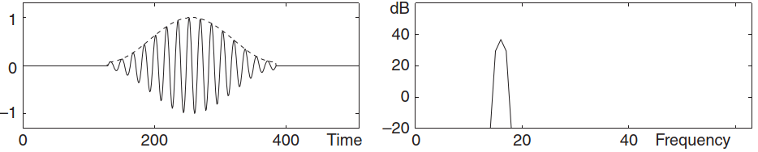
Effects of window selection
Rectangular window not in periodicity synchrony with the signal. Results in spreading of the spectrum.
Hamming window. Removes most of the spectral spreading, but the spectrum peak is broadened

Slide 32
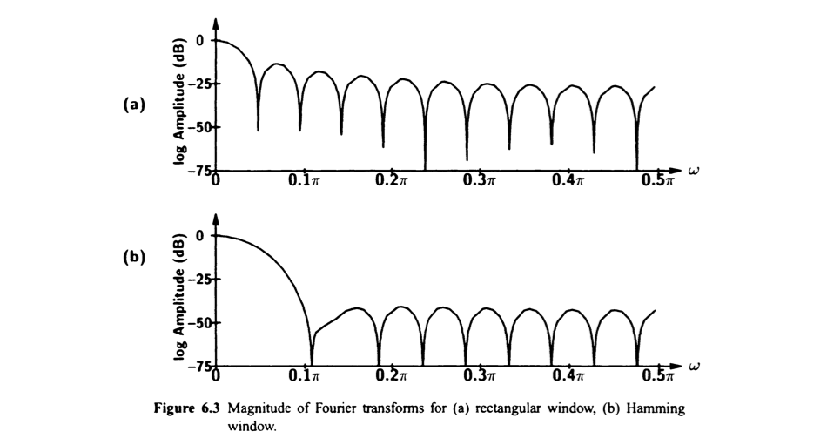
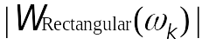
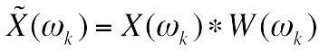
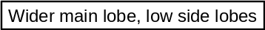
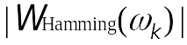
Rectangular vs Hamming window
Multiplication in time-domain is equivalent to convolution in frequency domain
Each spectral line is convolved
with the window response.
Rectangular window results in “ringing” (it creates additional frequencies)

Slide 33
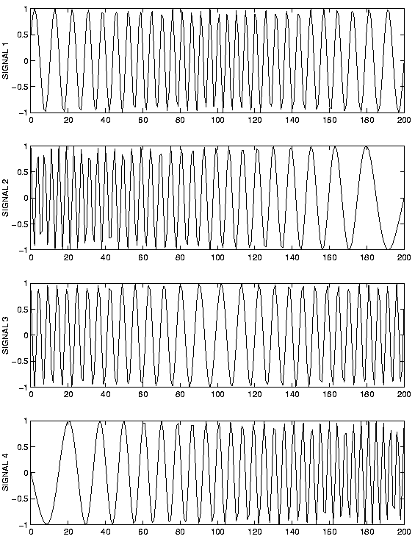

Thinking break (2 minutes) Match each signal to its spectrogram

Slide 34


Convolution
For discrete-time signals and linear time-invariant (LTI) systems the relationship between input $x\left(n\right)$ and output $y(n)$ signals can be expressed as
$$y\left(n\right)=x\left(n\right)∗h\left(n\right)= \sum_{i=−∞}^{+∞}{x\left(i\right)h\left(n−i\right)}.$$
Where $h(n)$ is the impulse response.
The mathematical operation of convolution is complex. However, Fourier transform converts the convolution into a simple multiplication.

Slide 35






Convolution examples
$$s_{1}(n)$$
$$s_{3}(n)$$
$$s_{2}(n)$$
$$s_{3}\left(n\right)= s_{1}\left(n\right)∗s_{2}\left(n\right)$$

Slide 36

Convolution
Used in room simulation (seen in Lecture 2), where the acoustics of a room are artificially reproduced. This is done calculating the convolution of the audio signal with the room impulse response.
Original speech
Simulated room
Simulated room (smaller dimensions)
RIR from a big hall

Slide 37

64 ms analysis window
Speech signal length: 3.4s
Sampling rate: 16 kHz
Window length: 64ms
Window type: Hann
current window index: 7

Slide 38

128 ms analysis window

Slide 39

32 ms analysis window

Slide 40

16 ms analysis window

Slide 41
Observations
Increasing the window length
Spectrogram has better frequency resolution
But worse time resolution in the STFT
Rectangular windowing
Spectral smearing
Specific windowing (e.g. Hann)
Better visibility of spectral peaks.

Slide 42
Considerations when calculating FFT
Frequency resolution
Zero-padding
Leakage

Slide 43



Frequency resolution
Increasing the number of input samples increase the resolution of the DFT.
In the example: two sinusoids, one at 5 Hz and the other at 6 Hz.
The two read peaks represent the frequencies.
Many samples have to be feed to the DFT in order to output the two really close frequencies.

Slide 44

Zero-padding
Appending zeroes to the end of your input signal.
Does not alter the frequency content. → Does not add useful information.
Interpolates the output spectrum.
From previous example, adding zeroes does not improve DFT resolution, we still can not identify the 5 Hz and 6 Hz frequencies.
More frequency bins → higher chance to accurately capture the exact frequency present.

Slide 45
Leakage
Phenomenon that happens when the energy of a frequency component is spilled out into other bins when it does not match up with an available bin frequency.

Slide 46

Notes:
For the red sinusoid, the DFT fall in-between the zero-crossings and then the leakage is revealed.

Slide 47

Correlation
We have seen how the dot product can be used to calculate transforms.
As mentioned before, it can be used to calculate similarity.
We can also calculate the amount of correlation between two signals using the dot product.
Positive correlation: two signals point in the same direction and increase/decrease together (Figure example).
Negative correlation: if one increase the other decrease and vice-versa.

Slide 48



Cross-correlation and autocorrelation.
Cross-correlation: correlation with two waveforms. In the example, a signal $x(t)$ and its time-delayed $x(t−100)$. The cross-correlation shows a peak indicating the time delay.
Autocorrelation: a signal is compared to itself; we can find its periodicity.

Slide 49
Extra material
Book about transformations.
Rhythm and Transforms. Sethares, William Arthur. author.2007. Chapter 10
Video to understand how Fast Fourier Transform works
https://www.youtube.com/watch?v=h7apO7q16V0

Slide 50
Summary
Frequency transform is often applied in modern audio processing applications
Importance of windowing
Considerations when calculating FFT

